Slide 1
OSI MODEL
Presented by
RUBIHAA JANANI

Slide 2
OSI
OSI means open system Interconnect model.
It consists of seven model
Each layer has different but specific process function.

Slide 3
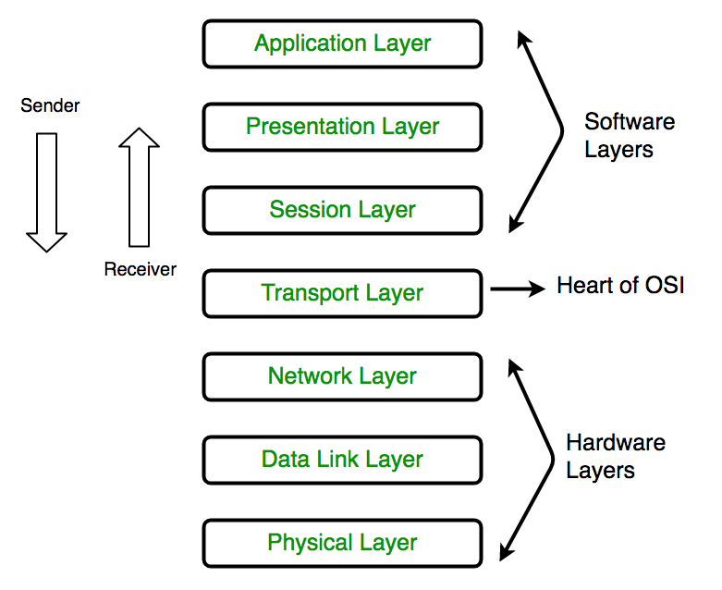
7-layers of OSI model:

Slide 4
1.Physical Layer :
The lowest layer of the OSI reference model is the physical layer.
It is responsible for the actual physical connection between the devices.
The physical layer contains information in the form of bits.
This layer will get the signal received and convert it into 0s and 1s and send them to the Data Link layer.

Slide 5
2. Data Link Layer :
The main function of this layer is to make sure data transfer is error-free from one node to another, over the physical layer.
Data Link Layer is divided into two sublayers:
Logical Link Control (LLC)
Media Access Control (MAC)

Slide 6
The functions of the Data Link layer are :
Framing: Framing is a function of the data link layer. It provides a way for a sender to transmit a set of bits to the receiver.
Physical addressing: After creating frames, the Data link layer adds physical addresses (MAC address) of the sender and/or receiver in the header of each frame.

Slide 7
Error control: Data link layer provides the mechanism of error control in which it detects and retransmits damaged or lost frames.
Flow Control: The data rate must be constant on both sides else the data may get corrupted thus, flow control coordinates the amount of data that can be sent before receiving acknowledgement.
Access control: When a single communication channel is shared by multiple devices, the MAC sub-layer of the data link layer helps to determine which device has control over the channel at a given time

Slide 8
3.Network Layer :
The network layer works for the transmission of data from one host to the other located in different networks.
functions of the Network layer :
Routing: The network layer protocols determine which route is suitable from source to destination. This function of the network layer is known as routing.

Slide 9
4. Transport Layer :
The transport layer provides services to the application layer and takes services from the network layer. The data in the transport layer is referred to as Segments.
The transport layer is also responsible for flow control and error control. Flow control determines an optimal speed of transmission to ensure that a sender with a fast connection doesn’t a receiver with a slow connection.
The transport layer performs error control on the receiving end by ensuring that the data received is complete.

Slide 10
5.The session layer
This is the layer responsible for opening and closing communication between the two devices. The time between when the communication is opened and closed is known as the session.

Slide 11
6.The presentation layer
The presentation layer is responsible for translation,encryption and compression of data.
Converting data into standard format.

Slide 12
7.Application layer
This is the only layer that directly interacts with data from the user.
This layer also serves as a window for the application services to access the network and for displaying the received information to the user.

Slide 13
THANK YOU

